Slide 1
Gaia-X Overview
Quick unofficial Introduction to Gaia-X and its achievement
by Perrin GRANDNE
Notes:
1

Slide 2
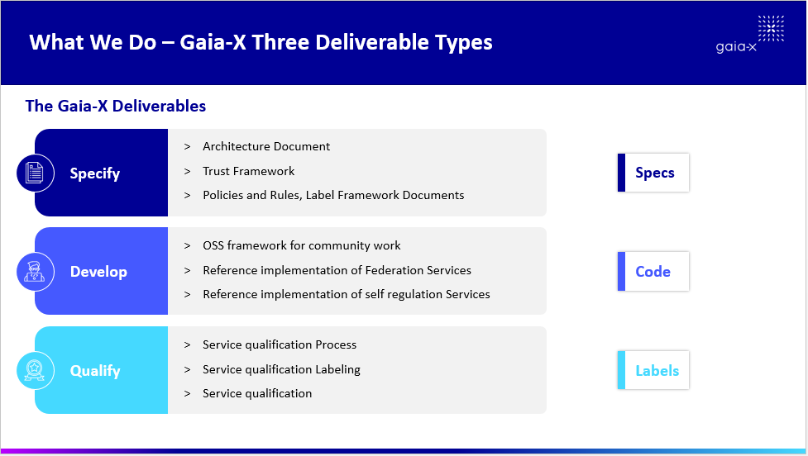

Slide 3







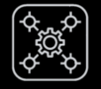





Resources
Last Releases of Gaia-X docs: https://gaia-x.eu/mediatech/publications/
  Gaia-X Architecture Document
  Gaia-X Trust Framework : https://gaia-x.gitlab.io/policy-rules-committee/trust-framework/
  Gaia-X Policy Rules Document and Labelling Criteria Document
Gaia-X Gitlab: https://gitlab.com/gaia-x
GXFS-DE : https://www.gxfs.eu/set-of-services/ (There is also GXFS FR who is working on a first implementation of a simple use-case)
Bullet 2
Bullet 3
3

Slide 4
Committee
Technical Committee
Policy and Rules Committee
Dataspace Business Committee

Slide 5
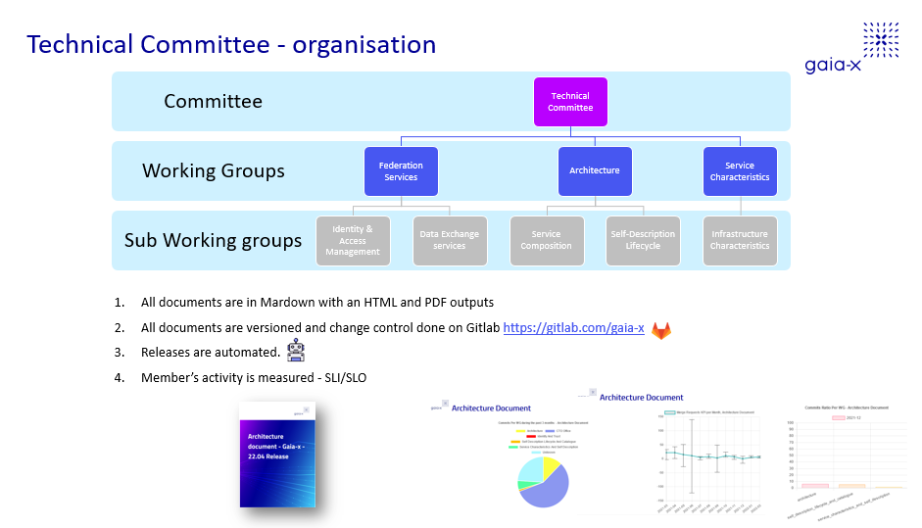

Slide 6
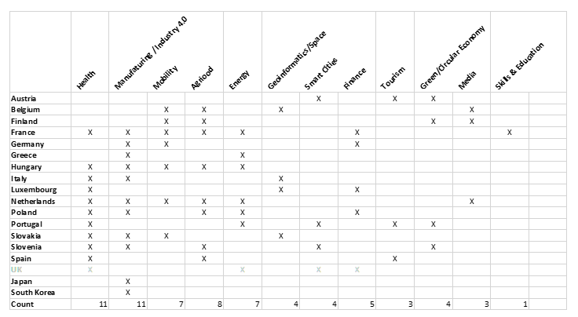
Gaia-X Dataspace

Slide 7
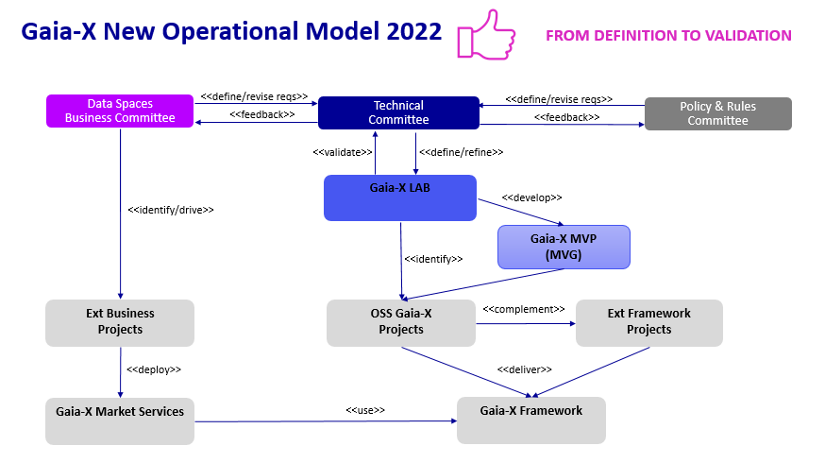

Slide 8
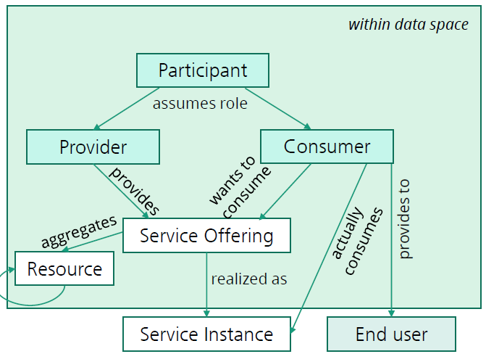
Conceptual Model
8

Slide 9
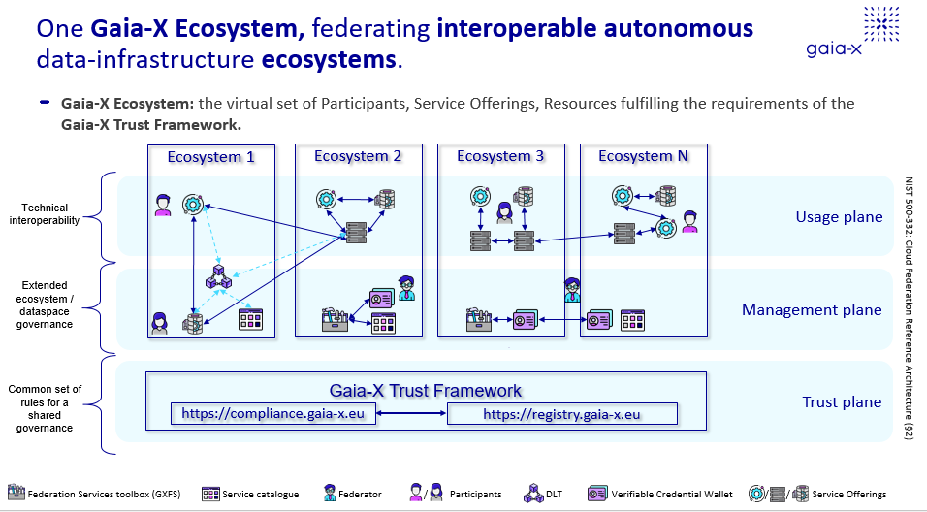
Notes:
Architecture Document

Slide 10
Resources of the Gaia-X Compliance Service
Development API: https://compliance.lab.gaia-x.eu/
Development Swagger UI: https://compliance.lab.gaia-x.eu/docs/
Production API: https://compliance.gaia-x.eu/
Production Swagger UI: https://compliance.gaia-x.eu/docs/
Repository: https://gitlab.com/gaia-x/lab/compliance/gx-compliance
Simple Self-Description Signer: https://github.com/deltaDAO/self-description-signer
Self-Description Generator: https://gaia-x.fit.fraunhofer.de/form

Slide 11
Onboarding
Gaia-X Lab Onboarding: https://onboarding-portal.lab.gaia-x.eu/
Gaia-X Federation Services Onboarding: http://80.158.90.9/
Gaia X Registry of Trust Anchor: https://registry.gaia-x.eu/docs/

Slide 12
Portals
Delta DAO:
  Portal: https://portal.minimal-gaia-x.eu/
  Catalogue: https://catalogue.minimal-gaia-x.eu/
  Self-Description Verifier: https://portal.minimal-gaia-x.eu/verify
EuPro Gigant: https://euprogigant.portal.minimal-gaia-x.eu/
DASES: https://lab.dases.eu

Slide 13
THANK YOU
Notes:
13

