Slide 1
Groupe gouvernance
Avril 2022

Slide 2

Ordre du jour
Point Plénière : ressenti
  PIA 4 / Agdathub / Valorisation du capital humain et des compétences (Investissement)
  Point de situation Prometheus-X à partir de la réponse BPI (Projection)
Point international
  Verticale européenne
  Hackathon France/Inde, issues ?
  Positionnement sur interopérabilité (voir suite)
Positionnement Data/act (demain)
  Point Laurine ?
Point GT :
  Traces, travail sur xAPI / Metavers ?
  Technique, test MVP, appel à contribution
  Compétences
  Mesure d’impact ?
Point information sur suite des EIG / continuité
Points divers

Slide 3
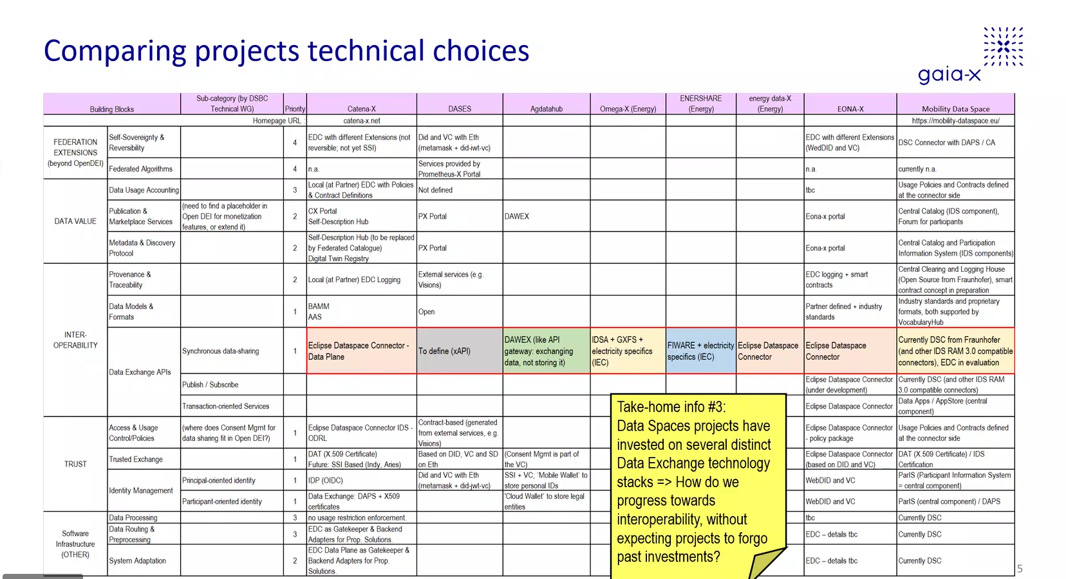

Slide 4
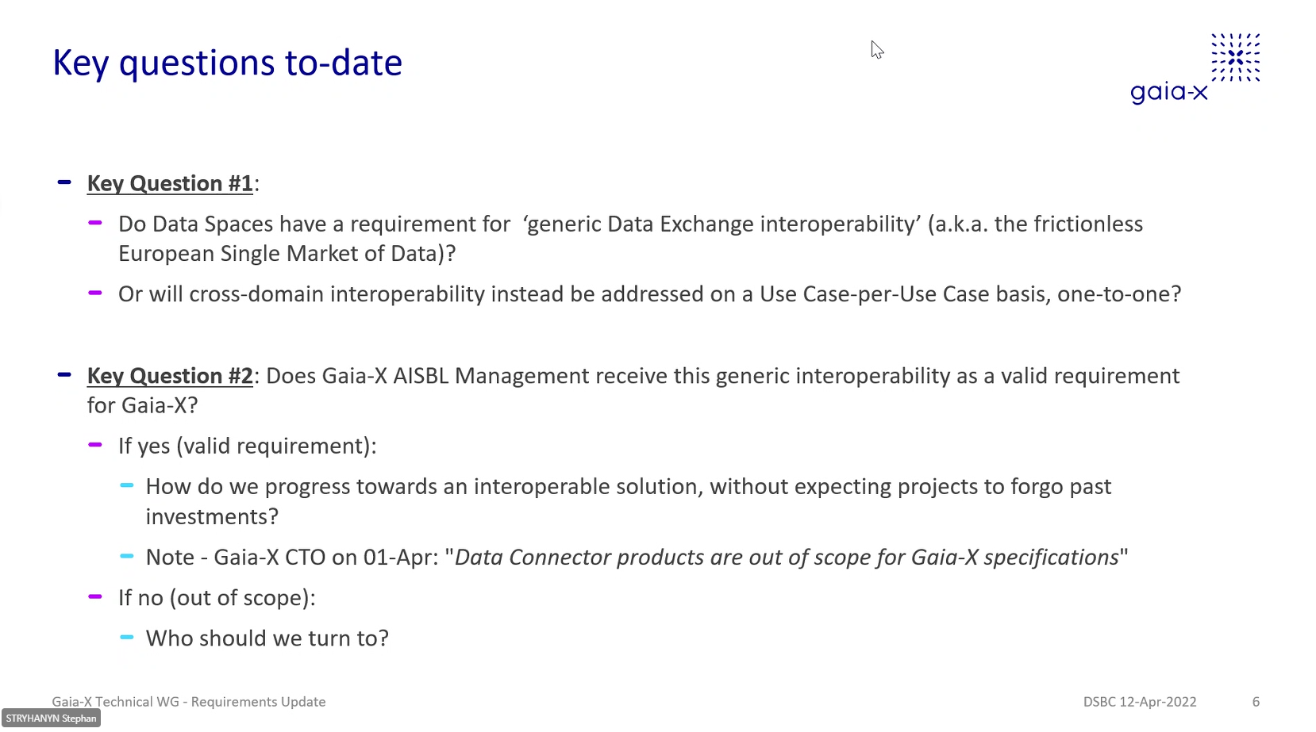

Slide 5
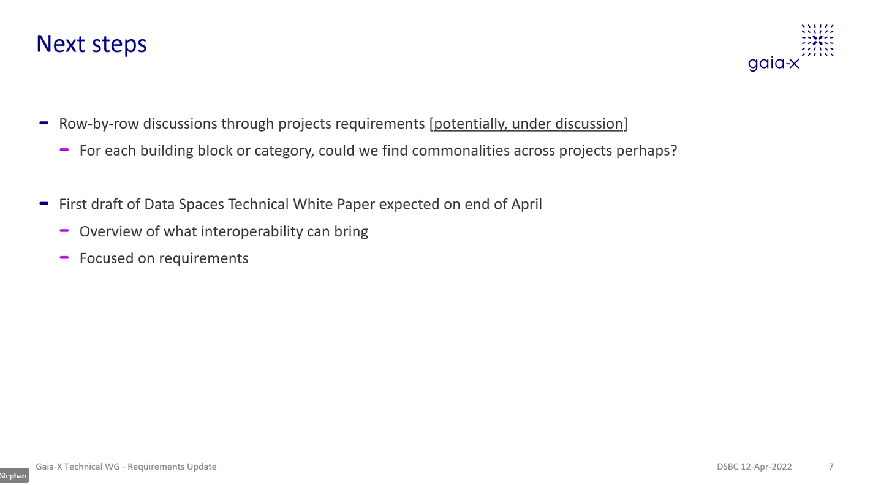
Nous devons apporter une réponse commune à notre verticale lors de la prochaine réunion

Slide 6
Status Verticals
CW 43/21
Vertical
Education & Skills
Lead
To be determined.
Achievements since last meeting
Activities until next meeting
Vertical session 5 scheduled on 5th of May
Documentation shared on French WG platform : https://prometheus-x.org/assemblies/dases-edu-skills-vertical-governance
Sub WG launched on learning analytics
Presentation of the MVP developed by the French group
Learning analytics WG 1st meeting scheduled (20/04)
Sub-WG on Pilot Erasmus+ application ucsecase (22/04)
EBSI calls (identity and diploma) : information to be provided on-going response to define vertical implication
English version of the MVP and testing sessions with vertical members
Issues, Risks, Decision needs
Issues : set up a European common roadmap, countries onboarding, use-cases to start concrete collaborations, identifying which solutions come from GAIA-X and what should be developed outside of it.
Risks : loss of convergence among actions, loss of time/efficiency
Decision needs : appropriate levels of governance to be built, funding opportunities to be found
=> Waiting from GAIA-X for WG labels & qualifications survey feedback and for position paper template

