Slide 1

DAta Space for Education & Skills
GAIA-X, Vertical Education & Skills

Slide 2
Share knowledge on respective national activities and projects
Capitalize on GAIA-X working groups’ inputs
Define a common vision => position paper
Work on pilot projects to demonstrate DASES added-value
Vertical targets

Slide 3
Agenda – May meeting
1. Brief summary of previous activities
2. MVP 2, new fonctionnalities
3. Current sub working groups
4. GAIA-X Governance / technical committees

Slide 4
1. Status Verticals
CW 43/21
Vertical
Education & Skills
Lead
To be determined.
Achievements since last meeting
Activities until next meeting
Vertical session 5 scheduled on 20th of May
Documentation shared on French WG platform : https://prometheus-x.org/assemblies/dases-edu-skills-vertical-governance
Sub WG launched on learning analytics & Erasmus+
Presentation of the MVP developed by the French group
https://daseslab.on.fleek.co/
Learning analytics WG meeting : 8/06
Erasmus+ application : to be scheduled
Testing sessions of the MVP with vertical members
Issues, Risks, Decision needs
Issues : set up a European common roadmap (position paper), countries onboarding, use-cases for concrete collaborations, identifying which solutions come from GAIA-X and what should be developed outside of it.
Risks : loss of convergence among actions, loss of time/efficiency
Decision needs : implication of the vertical group into GAIA-X governance, funding opportunities to be found

Slide 5

2. Evolution of the MVP

Slide 6
3. Sub WG update
Learning analytics
Erasmus+
https://annuel2.framapad.org/p/DASES-Erasmus-plus-application

Slide 7
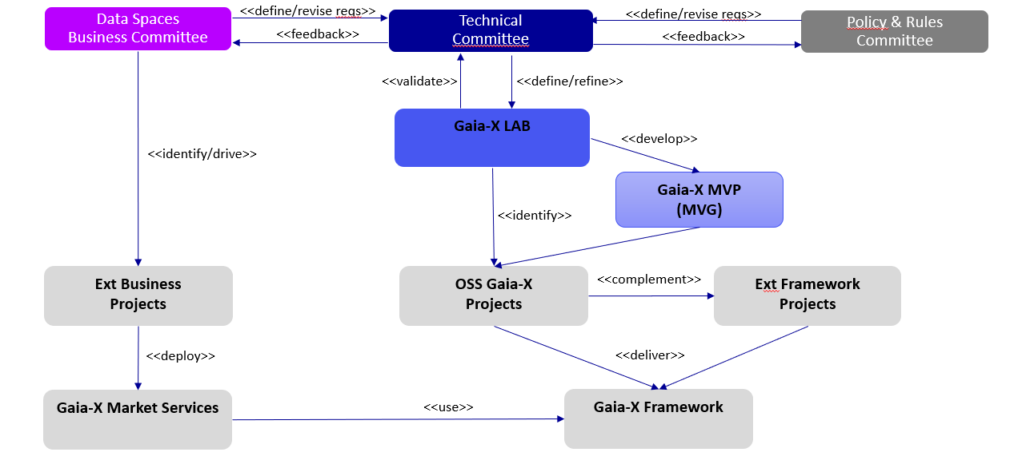
4. GAIA-X Governance & Technical committees

Slide 8
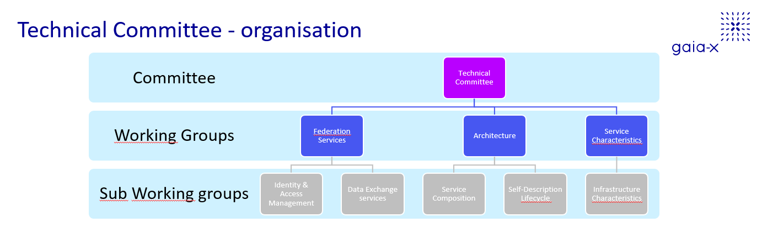

Slide 9
