Slide 1

DAta Space for Education & Skills
GAIA-X, Vertical Education & Skills

Slide 2
Share knowledge on respective national activities and projects
Capitalize on GAIA-X working groups’ inputs
Define a common vision
Build pilot projects to demonstrate DASES added-value
Vertical targets

Slide 3
Agenda – March meeting
1. Brief summary of previous activities
2. Vertical identity / how to share vertical work
3. DG Connect Call update
4. Presentation from Portugal - InCode 2030
5. Project brainstorming

Slide 4
Summary - Status Vertical
CW 43/21
Vertical
Education & Skills
Lead
To be determined.
Achievements since last meeting
Activities until next meeting
Vertical session 3 scheduled on 3rd of March
Sub-meetings :
28/1 : presentation of the response to the DG Connect Call on Skills Data Space Preliminary Study ;
4/2 : coordination model and governance ;
18/2 : Technical meeting on SSO/identity, contract and consent management model proposed by the French WG (Prometheus-X)
Representant of German Education Hub on board
Response to the DG Connect Call submitted
EBSI calls (to be discussed)
Countries onboarding
Issues, Risks, Decision needs
Issues : set up a European common roadmap, identifying the right countries‘ representatives to be brought on board and the right use-cases to start concrete collaborations, identifying which solutions come from GAIA-X and what should be developed outside of it.
Risks : loss of convergence among actions, loss of time/efficiency
Decision needs : use-cases priorities to start pilot projects, appropriate levels of governance to be built, funding opportunities to be found

Slide 5
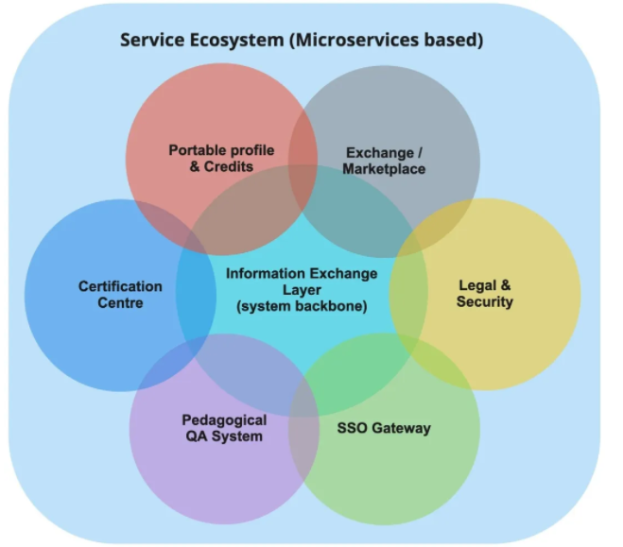

An ecosystem of DATA
Open data (Educational administrations)
School life and organization data
Skills data (students, citizens)
Learning and usage traces
Telemetry data (LMS and other platforms)
M. Aro, T. Neuvonen.
“Inclusive EdTech ecosystem for the 21st Century”

Slide 6
2. Vertical identity / how to share vertical work
Preliminary paper to be updated (EU dimension)
Existing solutions ? To be discussed
Ex. FR : https://prometheus-x.org/?locale=en

Slide 7
3. DG Connect Call update
advisory board
associated partners
procurement process
(Matthias de Bièvres)

Slide 8
4. Presentation from Portugal - InCode 2030
https://www.incode2030.gov.pt/en
(José Pedro Antunes)

Slide 9
5 / Brainstorming
    Commun project on digital skills ? Digital Education Action Plan / Action 9 Develop a European Digital Skills Certificate (EDSC) / on-going call for the a Feasibility Study
    Erasmus+ Key Action 1 => application for students to choose a university for exchange programs ?
    Mapping national specifications in terms of data protection, and possible additional requirements for data circulation in the field of education & skills
    EBSI Calls ? (Accelerating best use of technologies - DIGITAL-2022-DEPLOY-02)

