Slide 1
Vertical “Education & Skills”
French working group
December 2021

Slide 2

A Data Space Education & Skills for …
Students, Families & Citizens
Personalised learning environments
A lifelong guidance system
Relevant training (skills & labour market)
Decision-makers
Evidence-based decisions & prospective models
Data-driven management
Teachers, Universities
Reinforced knowledge of students’ needs
More relevant training & international mobility
Better understanding of education & guidance mechanisms
EdTech companies
Assess the impact of their solutions
Better understand users’ needs
Improving their outcomes

Slide 3


Projet Overview
Strengths
Digital Vision for Lifelong learning
GAIA-X as an Accelerator
Data
Data at all stages of life-long learning cycle (skills, school and extracurricular life, guidance, proctoring, etc.)
Stakeholders
Service providers, digital publishers, administrations and EdTech companies
An ambition in line with :
  EU Strategy for a digital Europe
  European Action plan 2021-2027 for digital education
  Data Governance Act
Boost Education data flow in a trustworthy environment
Foster EdTechs through data governance & reliable data
Unlock AI possibilities for new educational services

Slide 4





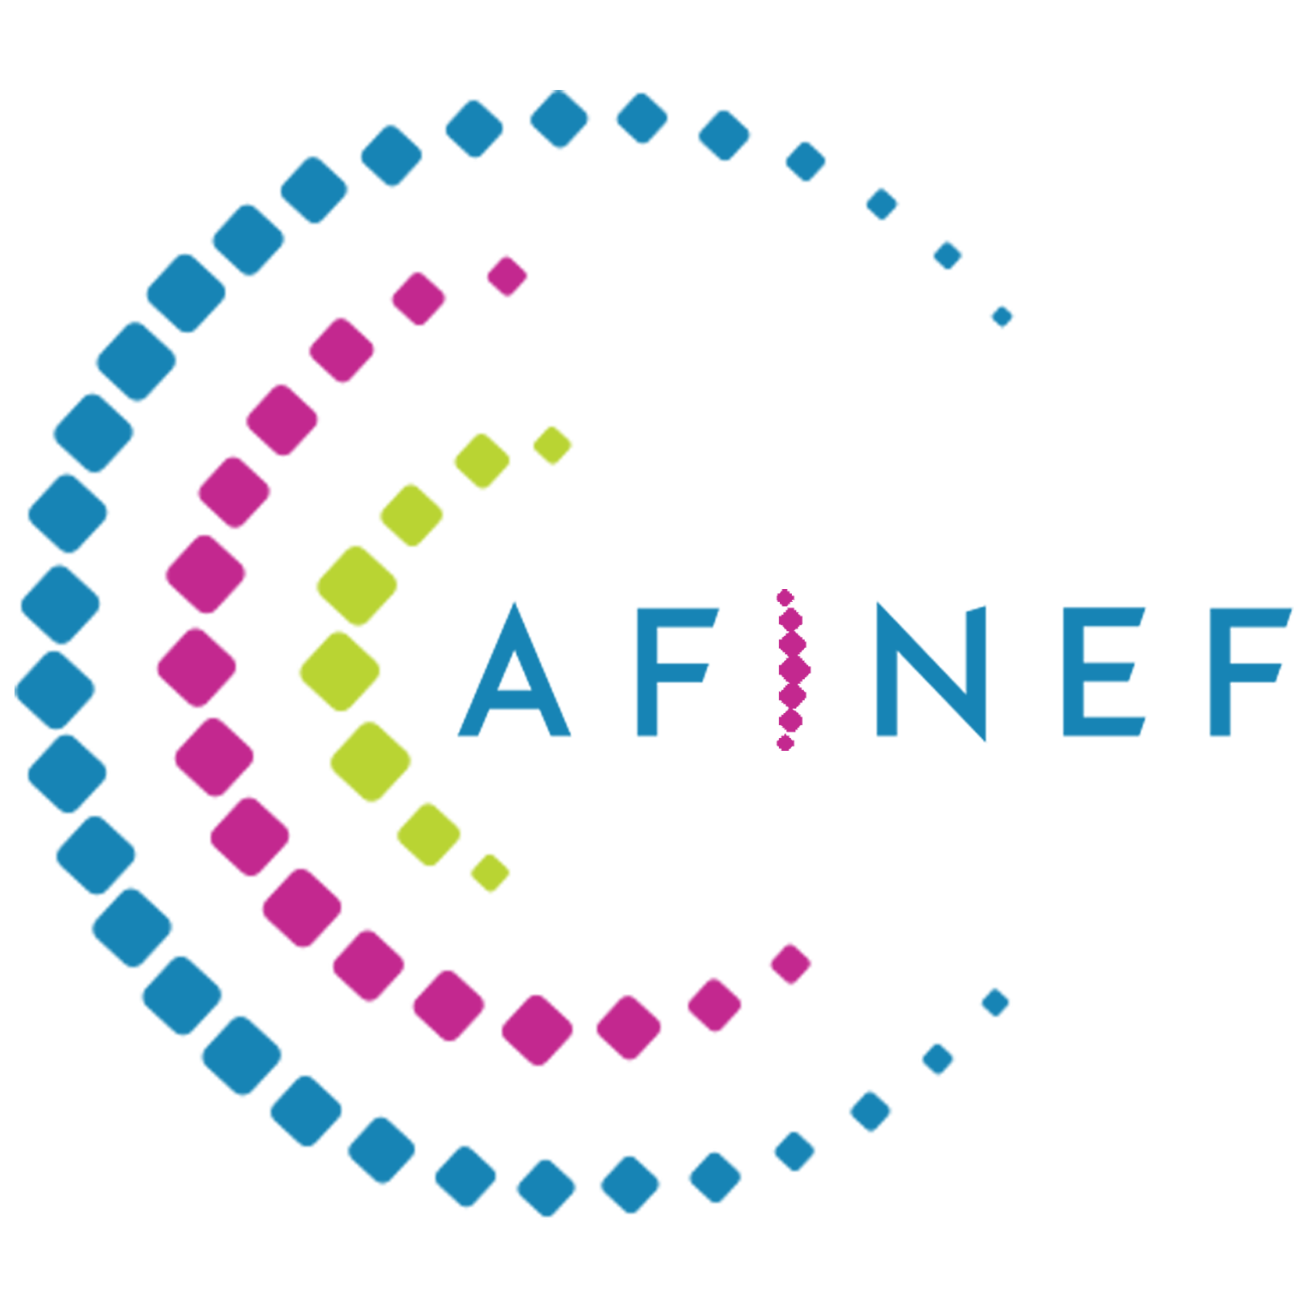







The French working group
A governance working group coordinated by the French Ministry of Education, Youth and Sport, with the main French critical stakeholders: EdTech associations (about 400 members) and public operators (Business France (business), INRIA (research), FEI (international cooperation) etc.) within GAIA X.

Slide 5







MERLOT
Ecosystem
Data Space energy
Other WGs
Education & Skills
Health Data Hub
BPI
Administrations
European
Data Space Education and Skills
PROMETHEUS
first technical building blocks
EdTechs
Data Hub
Agriculture
French Education Data Hub
French WG Education & Skills
Education & Training & Research Institutions
Gaia X Data Space
GAIA X DAO
Governance and Coordination of Gaia X Standard
GAIA X
(standards, regulations, policies for data spaces)

Slide 6
4 Key Needs
Governance
Skills
Datasets
4 IA
Tech core
Impact assessment
Human-centric
services & architecture
https://www.gaia-x.eu/use-cases

Slide 7
Functional key needs
Skills
Enable education, training and employment players to share data in order to offer better services to people (employment, training, pedagogy, etc.)
Enable people to benefit from personalized lifelong learning
Datasets : currently working on learning analytics
Allow stakeholders to identify and aggregate currently scattered datasets
Limit « cold start » problems for EdTechs
Unlock data sharing and use within a trusted environment
Larger datasets for better ML training
Impact assessment
Allow core players to share and to access to data measuring the impact of EdTech solutions
Ensure dataset interoperability for longitudinal or large-scale analyses

Slide 8
Technical
Infrastructure
PROMETHEUS
consent and identity management, AI matching, interoperability, traceability
Prometheus Platform
Infrastructure services providers members
Consumer members
Data providers members
Cstar, Inokofu, Visions, Tralalère, BCDiploma, Mindmatcher
+ cloud providers
MoE, Administrations, Universities, Local communities, Edtechs
c
GAIA X DAO
Governance and Coordination of Gaia X Standard
GAIA X
(standards, regulations, policies for data spaces)

Slide 9
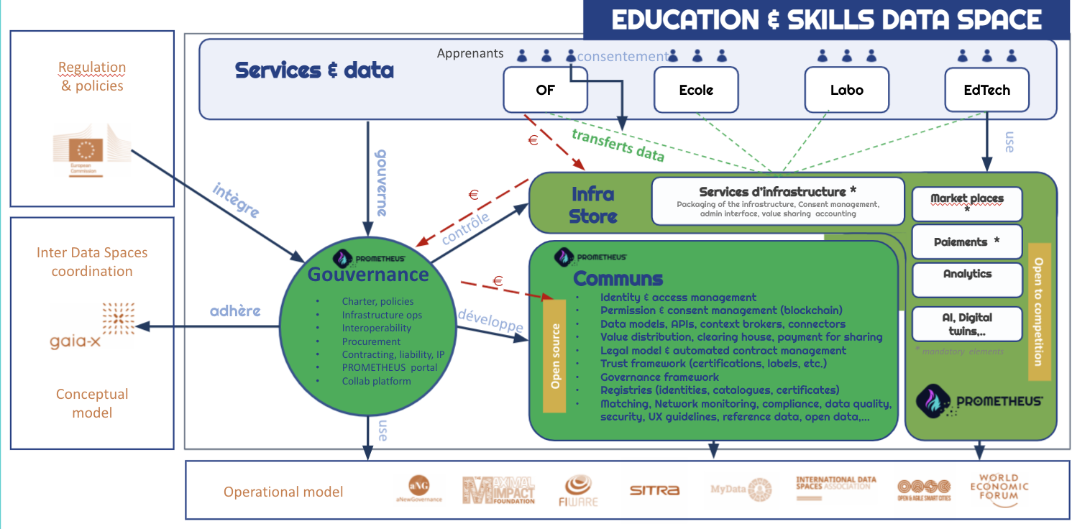
Technical
Infrastructure : Prometheus-X

Slide 10
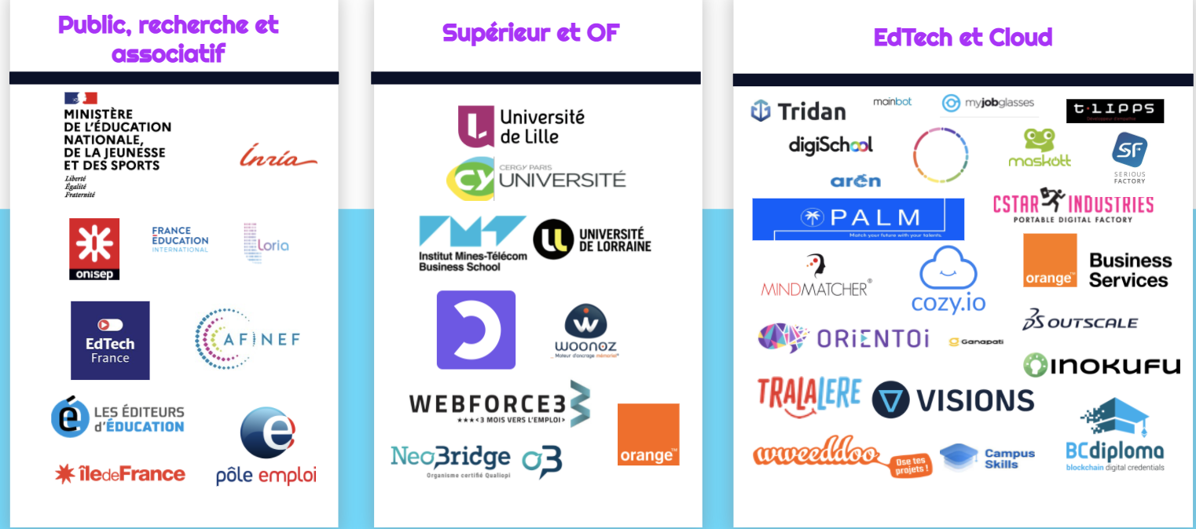
Supports

Slide 11
Timeline services
9 months Contracts
Consent
Identity
AI Services
24 mois :
Anonymisation / Pseudonymisation
Edtechs universal plugins
Skill data enhancement
5 months
Catalog
(data, services)
12 months :
Interoperability
services
Ontology Impact assessment

Slide 12
Thank you & Join us !
Trust and fair data to help you learn faster

